Slide 1
Thyroid Disorders
Department of Medicine

Slide 2
Function related – hypothyroidism
hyperthyroidism
Commonest endocrine problems
Goitre (enlargement) – diffuse, nodular
Carcinoma

Slide 3
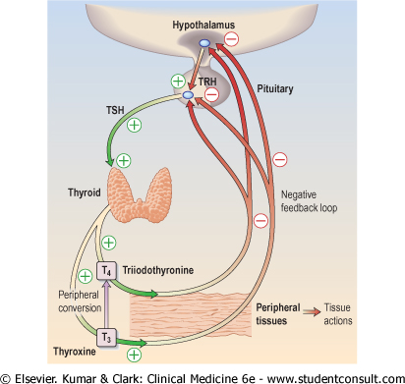
Hypothalamic-Pituitary-Thyroid Axis

Slide 4
Hypothyroidism

Slide 5
Types
Primary – disease of thyroid, common
Secondary – disease of hypothalamic-pituitary axis (↓ TSH), rare

Slide 6
Causes of Primary Hypothyroidism
Congenital
Defects in hormone synthesis –
iodine deficiency (common in SL → endemic goitre)
drugs – anti-thyroid, Lithium, Amiodarone
Autoimmune – Atrophic
Hashimoto’s
Post-partum
Infective
Post-surgery
Post-irradiation – I¹³¹
Infiltration - tumour

Slide 7
Atrophic (autoimmune) Hypothyroidism
Most common cause world-wide
Organ specific autoimmune disorder
Anti-thyroid Abs (microsomal-TPO thyroid peroxidase & thyroglobulin) → lymphoid infiltration → atrophy & fibrosis
Older females
Associated with other autoimmune disorders
eg DM, vitiligo, Pernicious anaemia

Slide 8
Hashimoto’s Thyroiditis
Late middle age - female
Atrophy with regeneration → goitre
Firm & rubbery gland
Hypo or euthyroid
Initial toxic phase in some – ‘Hashi-toxicity’
TPO Ab – high titres
Thyroxine shrinks goitre

Slide 9
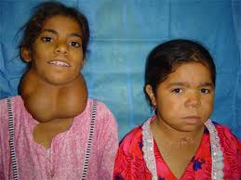
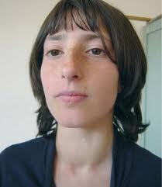
Iodine Deficiency
Causes ‘Endemic Goitre’
Euthyroid or hypothyroid
Supplementing salt with iodine reduces incidence

Slide 10
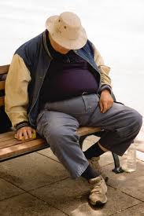
Symptoms
Female>Male
May be sub-clinical or mild
Tiredness
Weight gain
Deep voice
Depression / psychosis
Constipation
Menstrual disturbances
Cold intolerance

Slide 11
Signs
Goitre
Dry skin & hair
Bradycardia
Slow relaxing reflexes
Peripheral oedema
Over-weight / obesity
Anaemia
Mental slowness

Slide 12
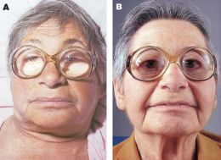
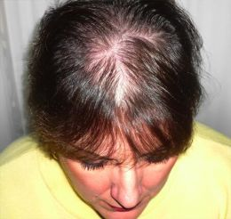
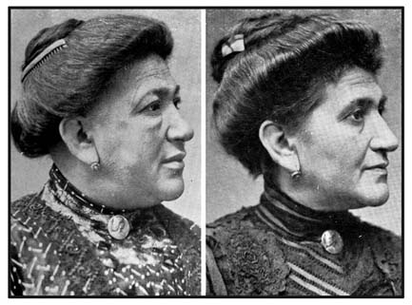
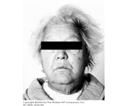

Slide 13
Investigations
TSH high, fT4 low
Auto antibodies – thyroid & other
Non-specific – anaemia
high CK
high AST
hypercholesterolaemia / >TG
low sodium

Slide 14
Treatment
Replacement with thyroxine for life
100 mcg daily initially
(elderly 50 mcg, IHD 25 mcg)
Check TSH after 6 weeks → increase by
25-50 mcg
Re-check TSH in 6-8 weeks
Increase dose till TSH normal

Slide 15
Maintenance → 100 – 150 mcg od
TFTs annually
Clinical improvement in 2 weeks
Full resolution of symptoms in about 6 months
Pregnancy – increase dose

Slide 16
Compensated euthyroidism
aka Borderline hypothyroidism
Low-normal T₄ with slightly raised TSH (5-10 mU/L)
May be following surgery or I₁₃₁ therapy
Repeat tests in 3-6 months
Treat with Thyroxine if -
TSH consistently >10 mU/L
symptomatic
high titre thyroid antibodies
lipid abnormalities

Slide 17
Myxoedema Coma
Rare presentation of severe hypothyroidism
More likely in elderly
Confusion, coma, hypothermia, cardiac failure, pericardial effusion, hypoventilation, hypoglycaemia, hyponatraemia
High mortality
Treatment – iv or oral T₃
Myxoedema Madness – dementia or psychosis
may also have delusions

Slide 18
Hyperthyroidism

Slide 19
Thyrotoxicosis or thyroid over-activity
Excess circulating thyroid hormone
Female : Male = 5:1
Most often 20-40 years
>99% due to intrinsic thyroid disease
Pituitary causes v.rare (↑ TSH)

Slide 20
Causes
Common - Graves’ disease (autoimmune)
toxic multi-nodular goitre
solitary toxic nodule / adenoma
Uncommon –
acute thyroiditis – viral, auto-immune, post-partum
gestational - HCG
neonatal – maternal Abs
exogenous iodine
amiodarone
thyrotoxicosis factitia

Slide 21
Graves’ Disease
Most common cause of hyperthyroidism
Auto-immune process –
IgG Abs (TSHR-Ab) binding to TSH receptors → stimulate T3/T4 production
Mostly 30-50 yr females
Diffuse thyroid enlargement

Slide 22
Graves’ Disease
Opthalmopathy
Pre-tibial myxoedema, dermopathy, thyroid acropachy – rare
Associated with other auto-immune disorders – Vitiligo, Myasthenia gravis
40% have single episode
Most have relapses & remissions – eventually many become hypothyroid

Slide 23
Symptoms
Great individual variation of clinical features
Weight loss despite increased appetite
Irritability & restlessness
Tremor
Breathlessness & palpitations
Heat intolerance
Diarrhoea
Itching
Oligomenorrhoea
Sweating

Slide 24
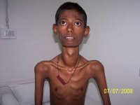
Signs
Tremor
Tachycardia / atrial fibrillation
High volume pulse with warm, vasodilated peripheries
Systolic hypertension
Goitre (bruit)
Lid lag & stare
Proximal myopathy

Slide 25
Eye signs, pretibial myxoedema, thyroid acropachy → only in Graves
AF, other tachycardias, heart failure → elderly
D/D – anxiety states

Slide 26
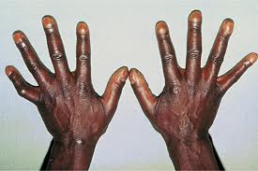
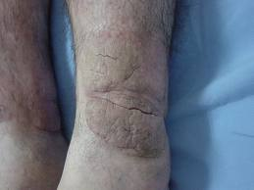
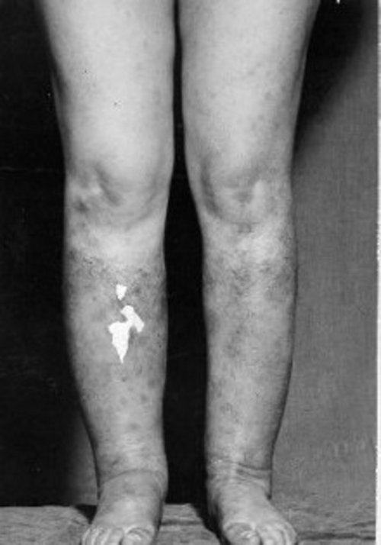
Thyroid Acropachy &
Pretibial Myxoedema

Slide 27
Graves’ Ophthalmopathy
Lid lag & ‘stare’
Grittiness, increased tearing
Exopthalmos
Proptosis & lid retraction → corneal ulceration
Opthalmoplegia, diplopia
Papilloedema
Loss of vision

Slide 28
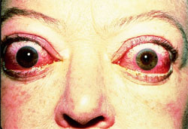
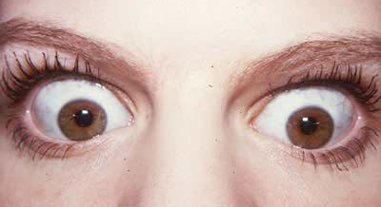
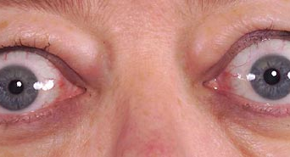
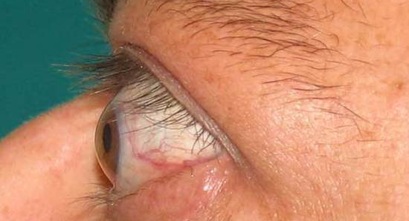
Graves’ Ophthalmopathy

Slide 29
Investigations
TSH suppressed
Free T4 & T3 elevated
TSH receptor Abs – not routinely tested
“T3 toxicosis”
TPO & anti-thyroglobulin Abs in Graves

Slide 30
Management
Anti-thyroid drugs
Radio iodine
Surgery

Slide 31
Choice of Therapy
Hard to predict natural history in individual patients
ATD for 18 months ………..watch
ATD for 18 months ………..surgery
ATD for 18 months ………..I¹³¹
I¹³¹ at presentation

Slide 32
Antithyroid Drugs
Carbimazole (or Methimazole) or Propylthiouracil – both equally effective
Inhibit formation of thyroid hormones
(CBZ is immuno-suppressive)
Gradual dose titration or Block & Replace
Clinical benefits take 10-20 days due to long half-life of T4

Slide 33
CBZ 20-40 mg daily for 4-6 weeks
Review – clinical, T3/T4 levels – adjust dose
Review in 2-3 months – adjust dose
Reduce to 5 mg daily over 6-24 months
Stop CBZ when euthyroid on 5 mg

Slide 34
Beta Blockers
For rapid symptom control
Propranolol 40-80 mg every 6-8 hours
Avoid in asthma, caution in heart failure
Stop when clinically euthyroid
NOT to be used alone

Slide 35
Relapse after Antithyroid Drug Therapy
50% within 2 years of stopping drugs
Unlikely to remit if –
large single / multi-nodular goitre
severe biochemical hyperthyroidism initially

Slide 36
Side-effects of Antithyroid Drugs
Agranulocytosis – 1/1000, within 3 months
Immediate medical attention if fever or sore throat
Rashes common
Toxicity on CBZ – change to PTU

Slide 37
Indications for
Surgery or Radioiodine Therapy
Patient choice
Persistent drug side effects
Poor compliance with drugs
Recurrent hyperthyroidism after drugs
Large goitre (surgery)

Slide 38
Radioactive Iodine I¹³¹
Destroys functioning thyroid cells
Takes several months to be fully effective
Must be euthyroid with drugs before RAI
Majority become hypothyroid – long term follow up essential
Contra-indicated in pregnancy & breast feeding
Opthalmopathy may worsen with I¹³¹

Slide 39
Surgery
Subtotal Thyroidectomy
Only in euthyroid patients
One year after surgery -
90% euthyroid
10% hypothyroid
1-3% recurrent hyperthyroid

Slide 40
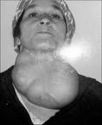
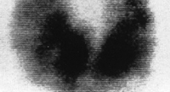
Toxic Multinodular Goitre
Female > 60 years
CVS features (AF, heart failure) predominate
I¹³¹ large doses + partial thyroidectomy
Antithyroid drugs rarely induce remission

Slide 41
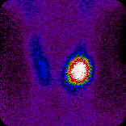
Solitary Toxic Adenoma
Rest of the gland atrophies due to suppression of TSH
Female >40yr
Radio isotope scanning useful for diagnosis
Rx → hemi-thyroidectomy, I¹³¹

Slide 42
‘Sick Euthyroid’ Syndrome
Low free T₄ and T₃
Normal or low TSH
During serious acute or chronic systemic illness
Interleukin mediated
Tests should be repeated after resolution of underlying illness

Slide 43
Thyroid Eye Disease
aka Dysthyroid eye disease or Ophthalmic Graves’ disease
Immune response causing retro-orbital inflammation → swelling and oedema of extra-ocular muscles
↑ pressure on optic nerve → optic atrophy

Slide 44
Thyroid Eye Disease
Usually bilateral but may be unilateral
Patient may be hyperthyroid, euthyroid or hypothyroid
TSH receptor Abs present
More common & severe in smokers
Exacerbations after I₁₃₁ therapy
Sight is threatened in a minority only

Slide 45
Investigations
TFTs
Document eye movements and degree of oedema & inflammation
Measure exophthalmos → monitoring response to Rx
MRI or CT of orbits

Slide 46
Treatment
Eye drops – methylcellulose or hypromellose
Sleeping upright
Tape eyelids shut at night
Systemic steroids
Surgical decompression of orbits
Lid surgery
Corrective eye muscle surgery
Irradiation of orbits
Immunomodulatory agents

